Slide 1

CLFusion:3D Semantic Segmentation Based on Camera and LiDAR Fusion
Tianyue Wang, Rujun Song, Zhuoling Xiao*, Bo Yan, Haojie Qin, Di He
Speaker
Tianyue Wang
2024/5/20
Notes:
Good afternoon, ladies and gentlemen. I would like to express my sincere gratitude to the organizers for this wonderful opportunity and to all of you for being here today. My name is Tianyue Wang, from University of Electronic Science and Technology of China. The topic of my presentation is "CLFusion" which explores three-dimensional Semantic Segmentation Based on Camera and LiDAR Fusion. A quick thank to my collaborators and mentors, couldn't have done it without them.

Slide 2

1
Background and significance
CONTENTS
2
Methods and processes
3
Results and analysis
4
Conclusion of paper
Notes:
I will introduce our work in the following four parts, Background and significance, Methods and processes, Results and analysis , and the Conclusion of this paper.

Slide 3
01
Background and significance
Notes:
First part, Background and significance.

Slide 4
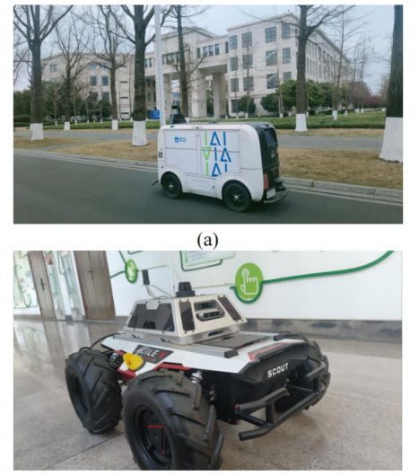
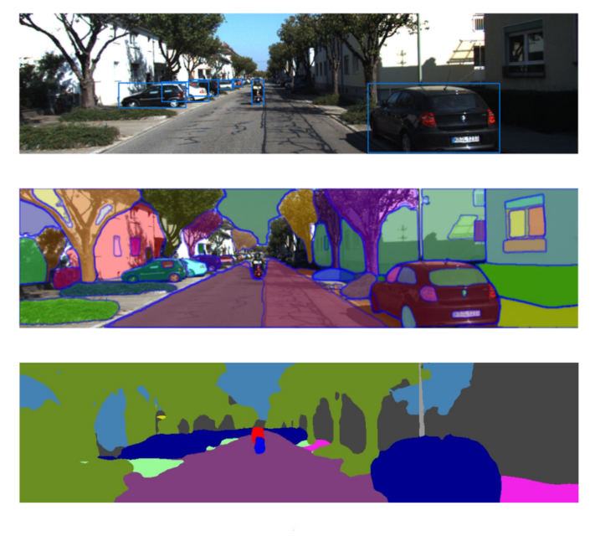
1
Background: perception task in autonomous
Notes:
With the development of autonomous driving and artificial intelligence, three-dimensional perception has become increasingly important. The semantic segmentation task aims to assign a corresponding semantic label to each camera pixel or Lidar point cloud input. On the one hand, semantic labels contribute to the safe autonomous movement of unmanned vehicles and robots. On the other hand, semantic segmentation can be combined with SLAM for high-precision semantic map construction.

Slide 5
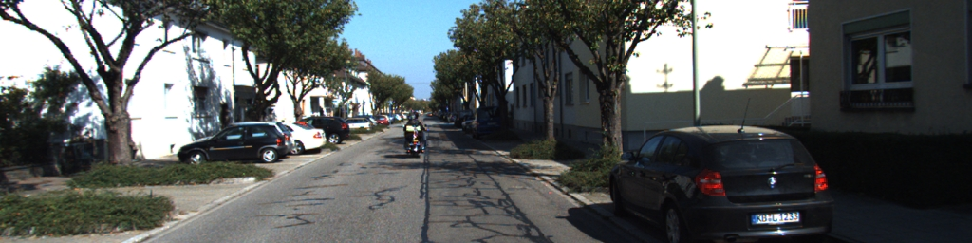
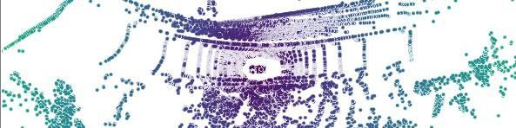
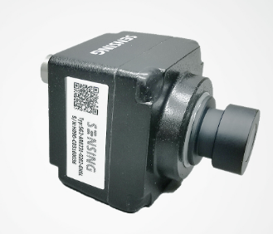
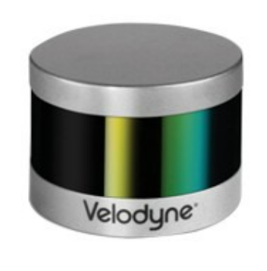
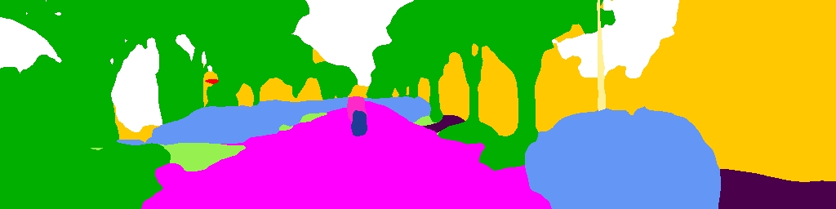
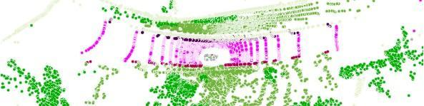


1
Background: different sensor
XYZ accurate distance of surrounding environment
Active sensors are not
affected by lighting onditions
color RGB
texture
Lack depth information
Affected by lighting
conditions
Only Intensity
Sparse point cloud
Notes:
Currently, the mainstream methods in the field of semantic segmentation include image-based, Lidar-based, and fusion-based methods. Image-based semantic segmentation use three-channel color data, which provides richer appearance information such as color and texture.
However, cameras lack depth information, making it difficult to obtain accurate distance information about the surrounding environment in most cases.
Lidar is an active sensor. It emits laser light to the outside to obtain the reflectivity of the surface of the object. The accurate distance can be calculated by the flight time, and its performance is almost unaffected under different lighting conditions. However, point clouds lack color information and have a non-uniform distribution, which makes them less accurate compared to image-based segmentation.

Slide 6
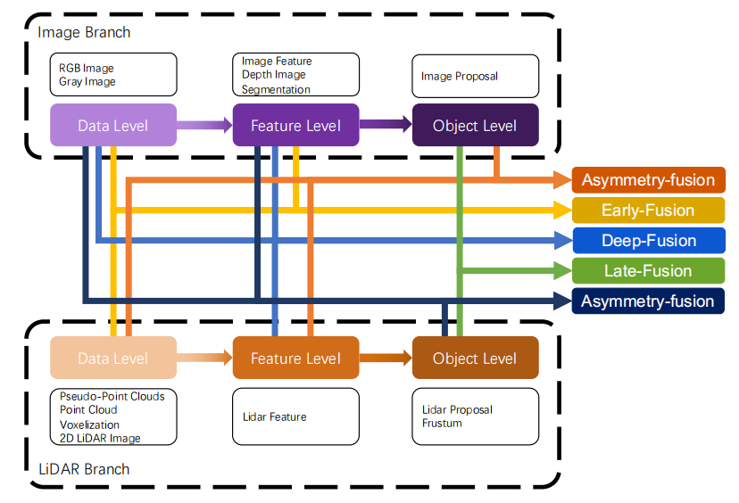
1
Background: fusion method
[1]Multi-modal Sensor Fusion for Auto Driving Perception: A Survey
Notes:
Therefore, the intuitive idea is to fuse two types of sensors to achieve better results.
This figure summarizes the methods of fusing cameras and LiDAR at different stages.
Early fusion refers to the fusion of raw data,
deep fusion usually occurs at the feature level,
and late fusion generally occurs at the result level.
Some methods do not fully meet these definitions are called asymmetry fusion.Overall, the fusion effect is better at the feature level.

Slide 7
02
Methods and processes
Notes:
Next, we will introduce our method, which also belongs to deep fusion.

Slide 8
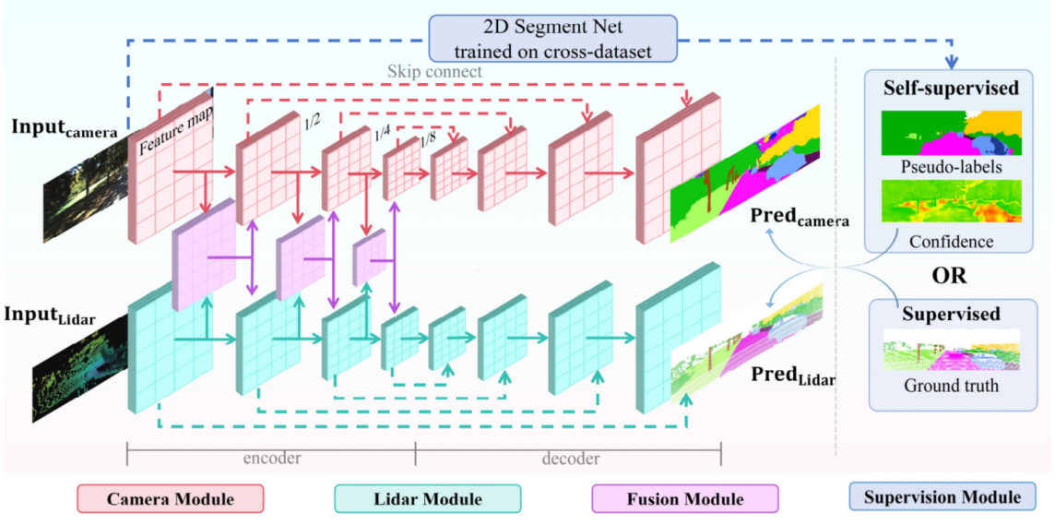
2
Methods: Overall framework
Notes:
The three-D semantic segmentation fusion network adopts a dual-stream fusion structure as shown in this Figure.
It is divided into four modules: Camera Module, Lidar Module, Fusion Module, and Supervision Module.
For Camera Module, the structure design of U-Net is used. The encoder part extracts image features layer by layer and performs downsampling through ResNet34, and the decoder fuses the original features through skip connect and performs upsampling layer by layer, ultimately restoring to the original scale. In the Lidar module, we adopt SalsaNext as the baseline.

Slide 9
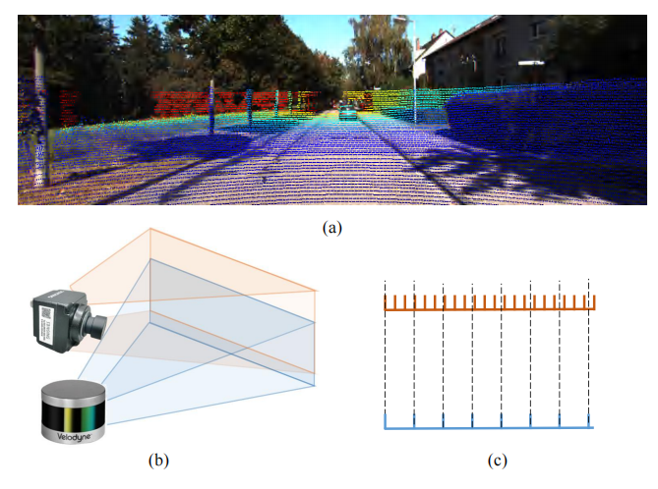
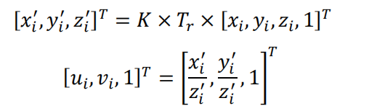
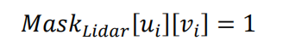
2
Methods: Point cloud projection
projection
3D 2D
Notes:
Due to the fact that point cloud data is three-dimensional and image data is two-dimensional, we project the point cloud onto the image plane for processing according to the following formula, where Tr is the camera extrinsic parameters.
K represents the intrinsic parameters. xyz prime denotes points in camera coordinates, and uv denotes the projection onto the image plane. Masklidar indicates the positions in the image where Lidar point clouds are mapped. However, in practical use, point clouds and images may experience misalignments, which can be caused by two possible reasons: spatial error and temporal error.

Slide 10
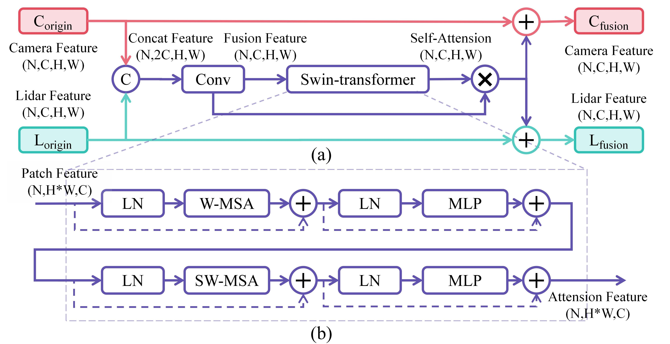
2
Methods: Fusion Module
Notes:
Therefore, we propose a fusion module that adaptively matches the features of different modalities through self-attention.The fusion module combines features from camera and Lidar. Firstly, the features are passed through the concat module and then processed by a convolutional layer to obtain the fusion features.
The fusion features are further processed by the Swin-transformer unit to obtain self-attention features. Finally, the attention features and fusion features are integrated into the original camera and Lidar features according to their respective weights.The Swin Transformer Unit consists of two blocks. Each block is composed of layer norm, Multi-head Self-Attention, layer norm, muti layer Multi-layer perceptron.
The difference between the two blocks lies in the implementation of self-attention used. One block uses the Windows Multi-head Self-Attention (W-MSA) structure, while the other block uses the Shifted Windows Multi-Head Self-Attention (SW-MSA) structure.

Slide 11
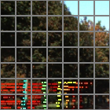
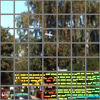
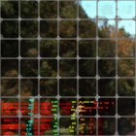
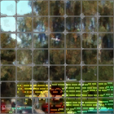
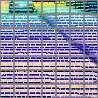
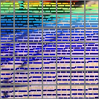
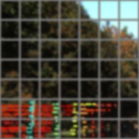
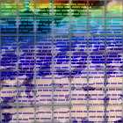
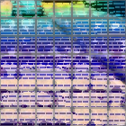
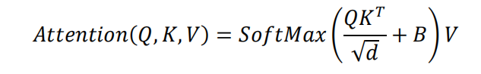

2
Methods: Window Multi-head Self-Attention
window
Q
resize
A
K
sequence
V
$$×$$
window msa
patch in window
Notes:
This is window mutihead self attention structure .The original features are divided into multiple windows, and within each window, the features are serialized and then linearly transformed to obtain three matrices QKV, representing queries, keys, and values. Calculate the similarity through Q and K, and assign weights V, B represents the relative position bias and d represents the dimension.

Slide 12
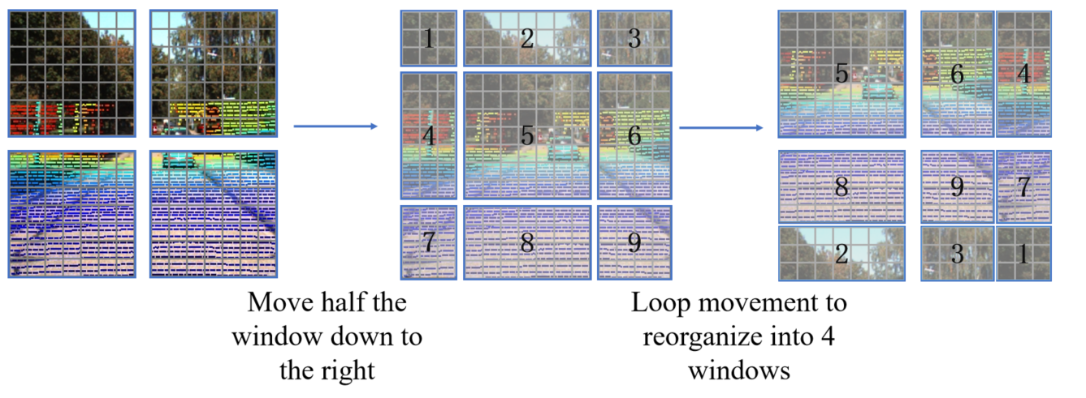
2
Methods: Shifted Windows Multi-Head Self-Attention
Notes:
However, this approach only calculates the attention within the window, so global attention is achieved by shifting the window. Through this method, adaptively selecting features in nearby spaces and enhancing them to improve the performance of the model.

Slide 13
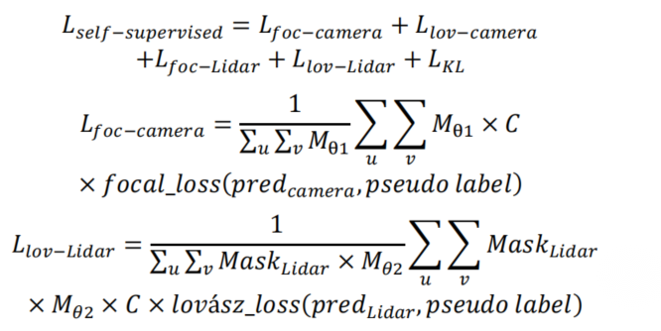
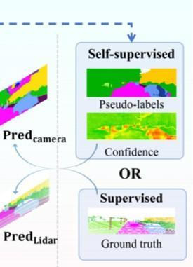
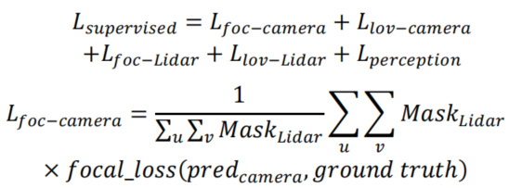
2
Methods: Supervision Module
Notes:
The Supervision module has two approaches: supervised learning using ground truth labels and self-supervised learning using pseudo-labels. In the supervised mode, we apply the focal loss, Lovász loss, and also incorporate the perception loss. We only calculate the various loss functions at the positions where masklida is equal to one.

Slide 14
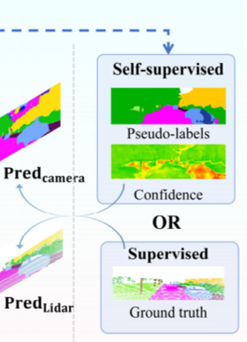
2
Methods: Supervision Module
Notes:
In the self supervised mode, the loss function is relatively similar. We use pidnet to generate pseudo labels, predict confidence based on the pseudo labels, and only consider areas with high confidence in the final calculation.

Slide 15
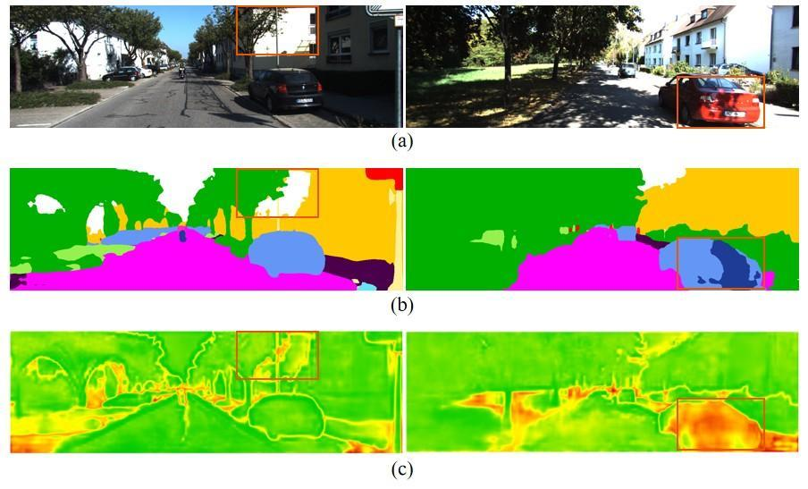
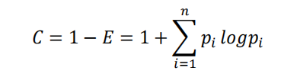
2
Methods: Pseudo label
Raw image
Pseudo label
Confidence
Notes:
From this graph, it can be seen that the prediction in the red box is incorrect and has a low confidence level.

Slide 16
03
Results and analysis
Notes:
The third part, Results and analysis

Slide 17
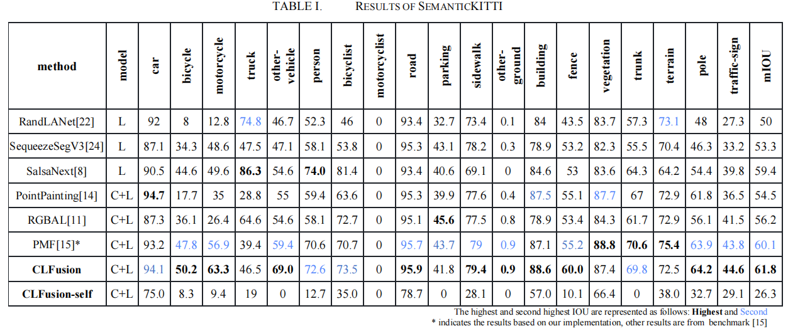
3
Results: SemanticKITTI
Notes:
We conducted experiments on SemanticKITTI and nuScenes datasets.Compared to the baseline SalsaNext, Table one shows that our supervised approach CLFusion improves overall performance by 2.4% on the SemanticKITTI dataset

Slide 18
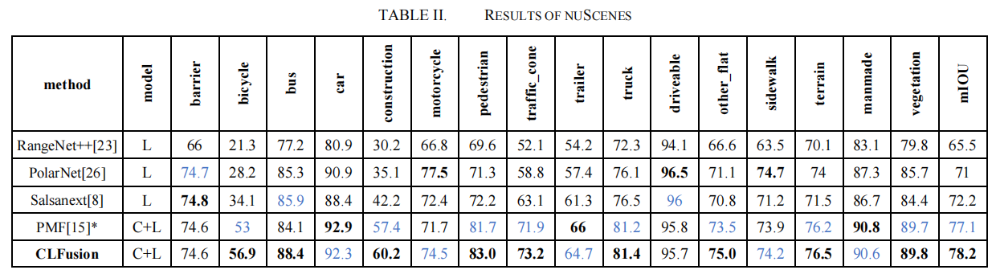
3
Results: nuScenes
Notes:
and 6% improvement on nuScenes. The inclusion of images leads to higher mIoU (mean Intersection over Union) for small object classes such as bicycle and motorcycle.

Slide 19
3
Results: SemanticKITTI
Notes:
The self supervised method is the lowest because there are many labels that cannot correspond during the process of pseudo label conversion. But we found that the results for car, road, building, and vegetation achieved relatively good results. These scenes are often the main components of a city and achieve relatively high scores

Slide 20
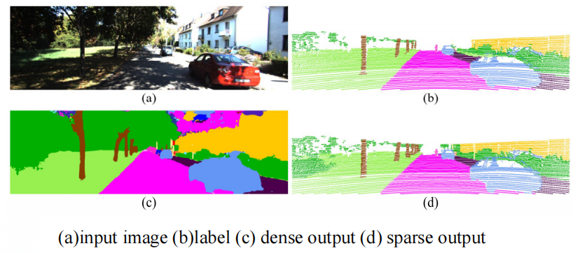
3
Results: 2D plane results
Notes:
Qualitative results are shown in this figure, where even though road boundaries become difficult to discern due to lighting and shadows, they are still accurately identified through the fusion method. Additionally, the network accurately predicts the outline of a person riding a bicycle in the distance, despite the sparse point cloud.

Slide 21
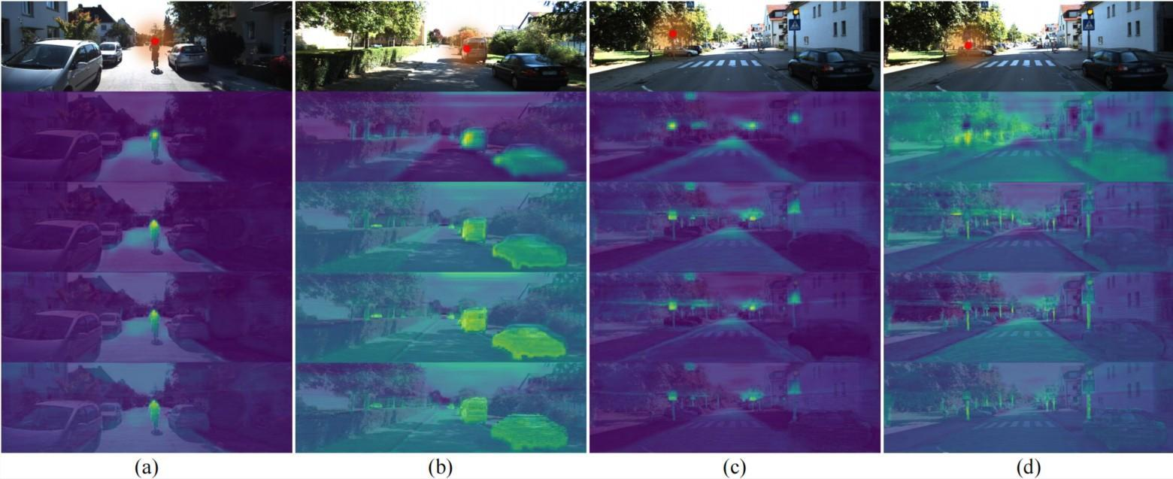
3
Results: Semantic heatmap
Notes:
In this image, we select specific areas indicated by red dots on the top row, compute attention at different decoder layers, and show correlation strength through a yellow-to-purple gradient.It can be seen that in shallower layers, objects with the same semantics also exhibit significant correlation.

Slide 22
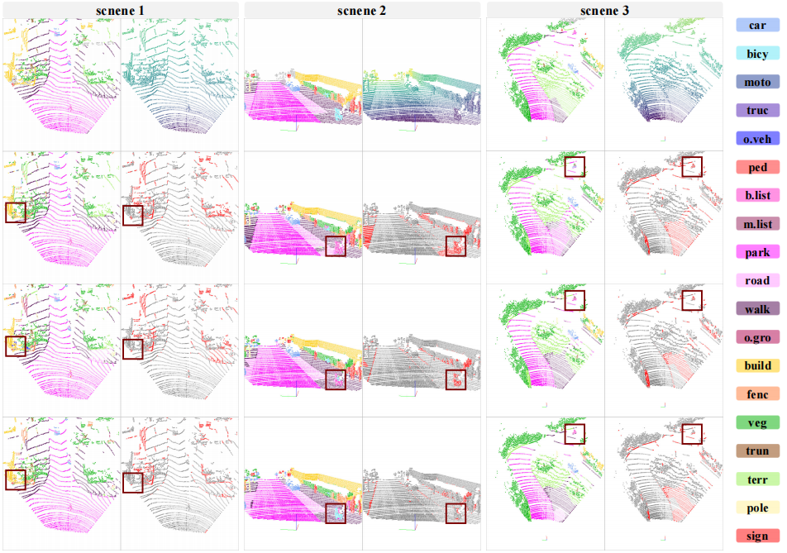
3
Results: 3D Results
Groundtruth
Salsanext
Single modal baseline
PMF
Multi modal baseline
CLFusion
OUR
Notes:
We compared the ground truth with three methods, namely single modal baseline, multimodal baseline, and our method clfusion. The error is represented in red, indicating that our method has the smallest error and accurately identifies pedestrians, bicycles, and cyclists in complex backgrounds.

Slide 23
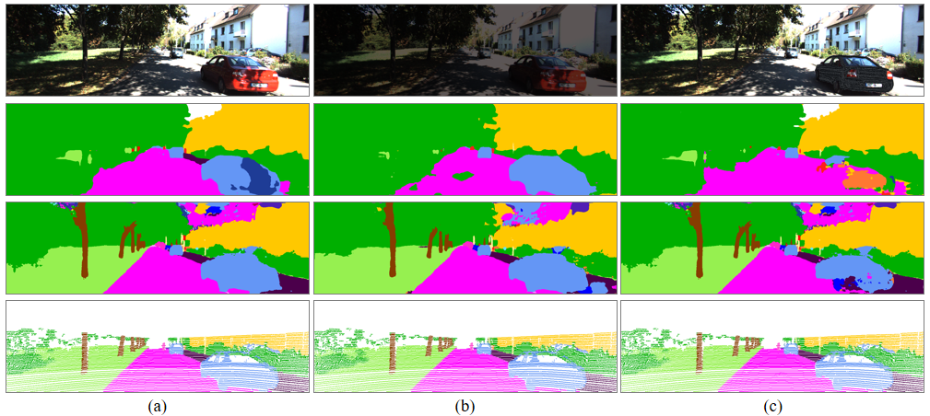
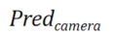
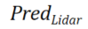
3
Results: Robust
Do not make any changes
Change brightness
Change car color
image
camera
only
Notes:
Some unsupervised approaches directly assign the image results to the point cloud. However, we did not adopt a similar approach because camera-only semantic segmentation is not robust enough for special scenes. In the experiments shown in Figure, we changed the brightness of the images and changed the color of the cars. The camera based pure vision method has been greatly affected, while our fusion method is slightly affected in image prediction results, and the Lidar prediction results are almost unaffected, proving its robustness.

Slide 24
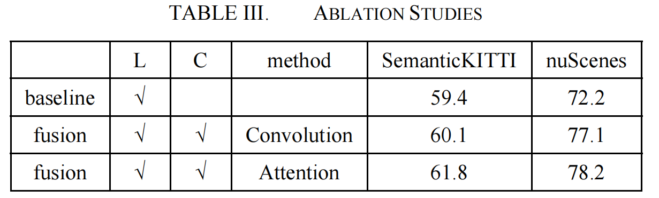
3
Results: ablation
Notes:
Finally, the ablation experiment showed that the fusion method of adding image and self- attention improved the performance of the model.

Slide 25
04
Conclusion of paper

Slide 26
4
Conclusion
The attention improvement is 2.4% on SemanticKITTI dataset and 6% on nuScenes dataset.
Compared with the camera-only solution, it is more robust.
The superiority of this model has been verified in the self-supervised field.
Notes:
In conclusion, we've presented an innovative fusion method for three dimension Semantic Segmentation Based on Camera and LiDAR Fusion. Compared to the pure Lidar method, improvements were achieved in both datasets. Compared to pure camera solutions, it is more robust. Finally, the self supervised approach demonstrates the superiority of this structure while enormous potential.﻿

Slide 27
Thanks for listening!
CLFusion:3D Semantic Segmentation Based on Camera and LiDAR Fusion
Tianyue Wang, Rujun Song, Zhuoling Xiao*, Bo Yan, Haojie Qin, Di He
Notes:
Thank you all for listening. Now is the Q&A stage, I'm eager to hear your thoughts, questions, or discussions on my paper, let's keep the conversation going.
Thanks again for your time and attention.

Slide 28
05
Appendix

Slide 29
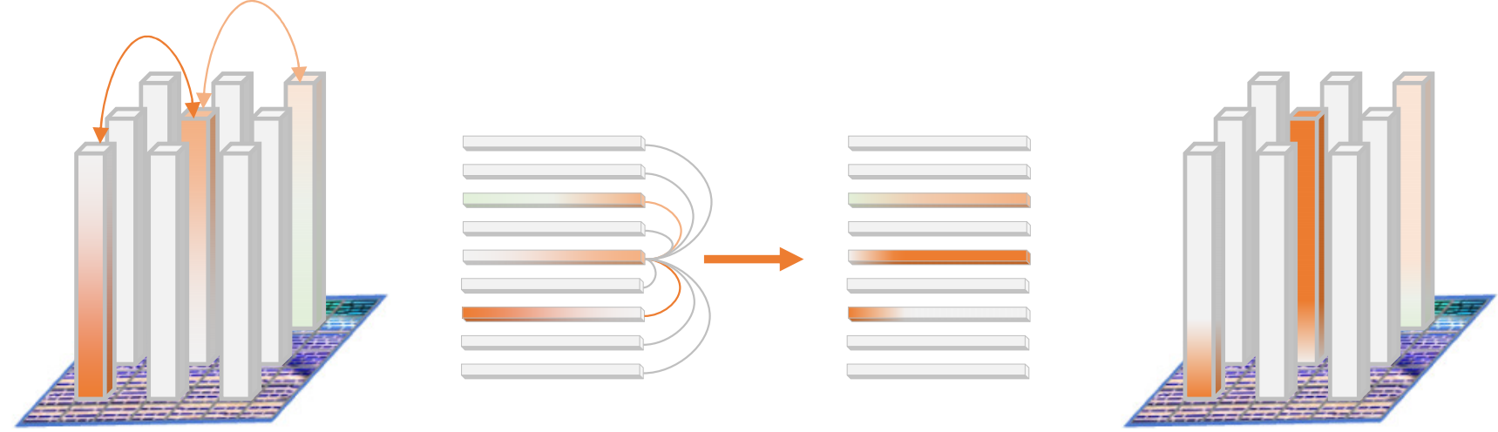
5
Appendix ：how attention work
Notes:
The principle of enhancing spatial adaptation by self attention features is shown in the figure.
On the one hand, the self attention mechanism effectively identifies and aggregates features from different positions but belonging to the same category (such as the orange features shown in the figure) by calculating similarity using Q and K within the local window, even if they have some deviation in spatial distribution.
This process strengthens the inherent connection between similar features and highlights semantic consistency. On the other hand, in response to the differences in the expression of the same category in different modalities (such as orange and green features representing different expressions of the same category in bimodal), the self attention mechanism achieves a feature space transformation between modalities through a linear transformation of value V, thus bridging the performance gap of modal characteristics.
Therefore, using Transformer attention can solve the two major challenges of cross modal fusion at once: alleviating spatiotemporal alignment errors and unifying semantic features between modalities.

Slide 30
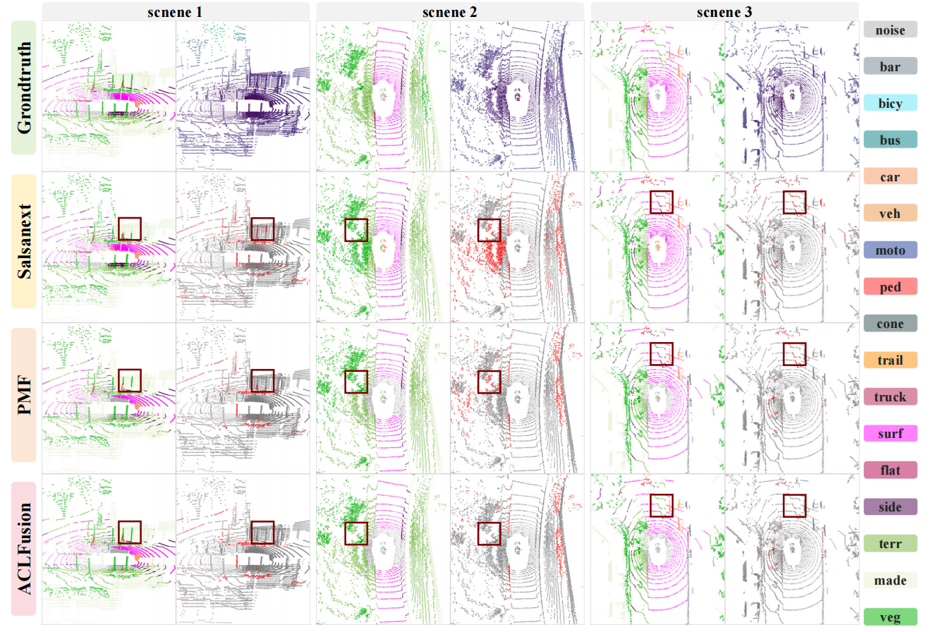
5
Appendix: nuscenes results

Slide 31
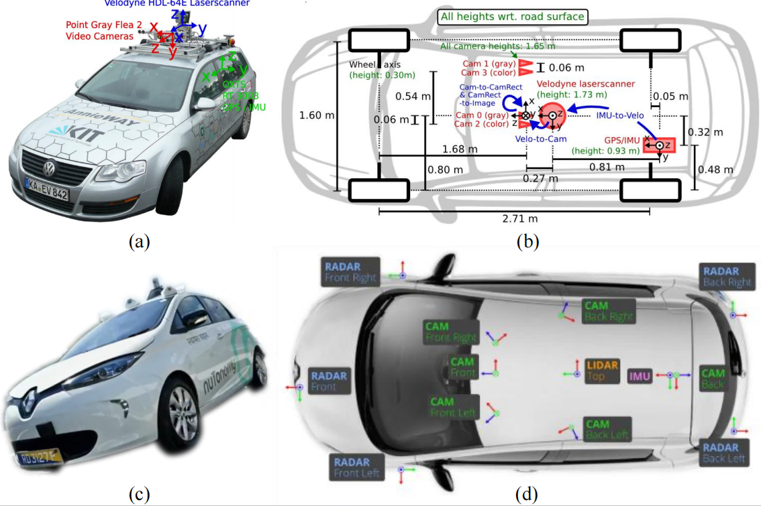
5
Appendix : Data collection vehicle

